Slide 1
Routers, Networks, and Routing Information: Some Basics
Routing Table
A communication network connects a set of nodes through links so that traffic can move from an originating node to a destination node

Slide 2
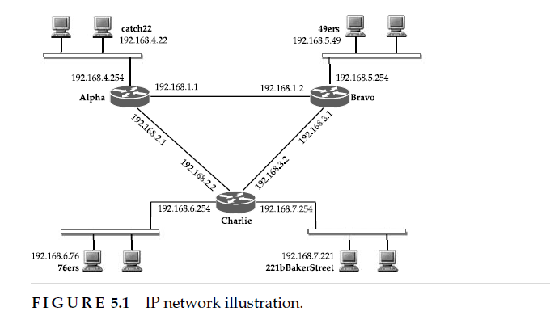
Routers, Networks, and Routing Information: Some Basics

Slide 3
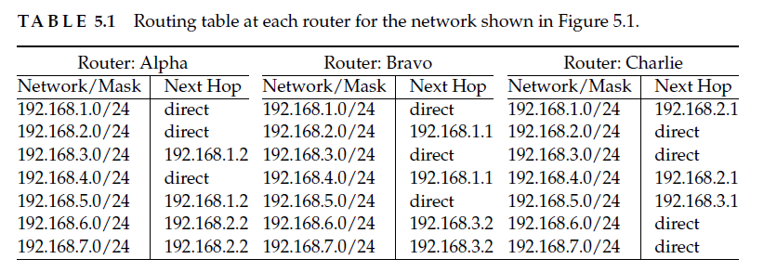
Routers, Networks, and Routing Information: Some Basics

Slide 4
Communication of Routing Information
An important aspect of the TCP/IP protocol stack is that all types of communications must take place within the same TCP/IP stack framework; that is, there are no separate networks or channels or dedicated circuits for communicating control or routing messages separately from user traffic
To accommodate different types of messages or information, the TCP/IP stack provides functionalities at both the IP layer and the transport layer; this is done differently for different routing protocols. For example, in the case of the RIP protocol, messages are communicated above the transport layer using a UDP-based port number; specifically, port number 520 is used with UDP as the transport protocol

Slide 5
How about other routing protocols?
BGP is assigned port number 179 along with TCP as the transport protocol. However, for several routing protocols, identification is done directly above the IP layer using protocol number field;
for example, protocol number 9 for IDRP protocol,
88 for EIGRP,
and 89 for OSPF protocol.
It may be noted that reliability of message transfer in BGP is inherently addressed since TCP is used;
however, for OSPF and EIGRP, which require reliable delivery of routing information, reliability cannot be inherently guaranteed since they are directly above the IP layer; thus, for communication of routing information in OSPF,
for example, through flooding, it is required that the protocol implementation ensures that communication is reliable by using acknowledgment and retransmission (if needed).

Slide 6
Distance vector protocols RIP, IGRP, and EIGRP.
Distance vector routing protocols :- Routing Information Protocol, Version 1 (RIPv1)
Routing Information Protocol, Version 2
Interior Gateway Routing Protocol
Enhanced Interior Gateway Routing Protocol
Link state routing protocols :- Open Shortest Path First (OSPF)
Intermediate System to Intermediate System (IS-IS)
Path vector routing protocol : - Border Gateway Protocol (BGP), used in the Internet.

Slide 7
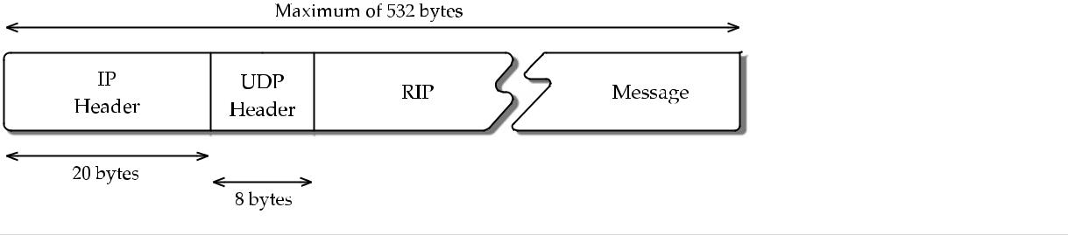
Routing Information Protocol, Version 1 (RIPv1)
RIP is the first routing protocol used in the TCP/IP-based network in an intra domain environment
RIP described here is loosely based on the program routed, distributed
RIP remains one of the popular routing protocols for a small network environment.
As a commonly accepted convention in IP, the packet format for RIPv1 is shown in 32-bit (4-byte) boundaries. A RIPv1 message has a common header of 4 bytes, followed by a 20-byte message for each route for which the message is communicating, up to a maximum of 25 routes/addresses. Thus, the maximum size of a RIP message (including IP/UDP headers)
20 + 8 + 4 + 25 × 20 = 532 bytes while the minimum is 20 + 8 + 4 + 20 = 52 bytes

Slide 8
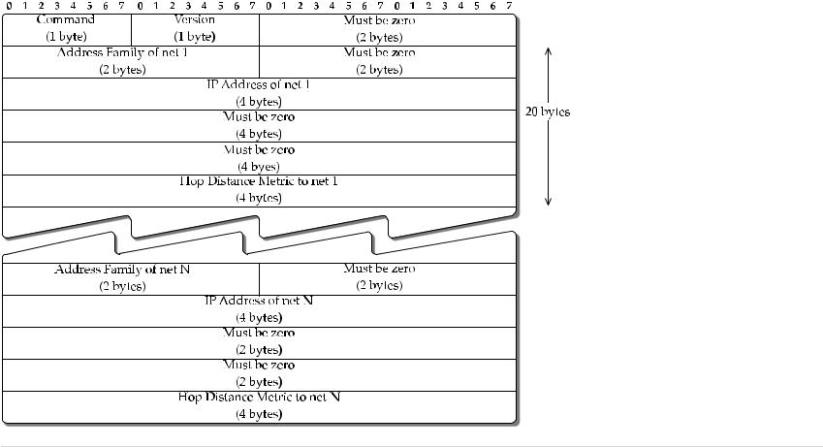
RIPv1 packet format.

Slide 9
Version (1 byte): This field indicates the RIP protocol version. This is set to 1 for RIPv1. If this field happens to be zero, the message is to be ignored.
Address family identifier (2 bytes): This field identifies the address family. This is set to 2 for the IP address family. Originally, the intent was to provide RIP for other address families, although in practice this RIP packet format has not been used for any other address family. There is a special use case when this field is set to zero; see command field be-low.
IP address (4 bytes): This is the destination network, identified by a subnet or a host.
Metric (4 bytes): This is based on hop count; it is a number between 1 and 16 where 16 means unreachable or infinity.
Command (1 byte): This field is used for different command sets in a RIPv1 message. While
there were five different commands originally defined, only two are used: request and response; the others are obsolete.
The request command can be used by a router to request a neighbouring router for distance vector information.

Slide 10
General Operation
The following are the primary operational considerations in regard to the RIP protocol:
General packet handling: if any of the must-be-zero fields have nonzero values anywhere or if the version field is zero, the packet is discarded.
Initialization: when a router is activated and it determines that all the interfaces are alive, and it broadcasts a request message that goes to all interfaces in the ‘request-ful’ mode. The neighboring routers handle responses following the split horizon rule. Once the responses are received, the routing table is updated with new routes the router has learned about.
Normal routing updates: in the default case, this is done approximately every 30 sec (‘Autoupdate timer’) where updates are broadcasted with command fields set to the re-sponse mode; as discussed earlier about timer adjustment a large variation is added to avoid the pendulum effect.
Normal response received: the routing table is updated by doing the distributed Bellman Ford step; only a single best route is stored for each destination.
Triggered updates: if the metric for an addressable network changes, an update message is generated containing only the affected networks.
Route expiration: if an addressable network has not been updated for 3 min (‘expiration timer’) in the default case, its metric is set to infinity and it is a candidate for deletion. However, it is kept in the routing table for another 60 sec; this extra time window is referred to as garbage collection or ffush timer.

Slide 11
Routing Information Protocol, Version 2 (RIPv2)
RIPv2 extends RIPv1 in several ways.
Most importantly, it allows explicit masking;
authentication is also introduced.
Authentication refers to using some mechanism to authenticate the message and/or its contents when a router receives it in such a way that it knows that the data can be trusted.
To do that, changes were introduced in the RIP message format from v1 while keeping the overall format similar by taking advantage of fields previously marked as must be zero. This also shows why when designing a protocol, it is good to leave some room for future improvement

Slide 12
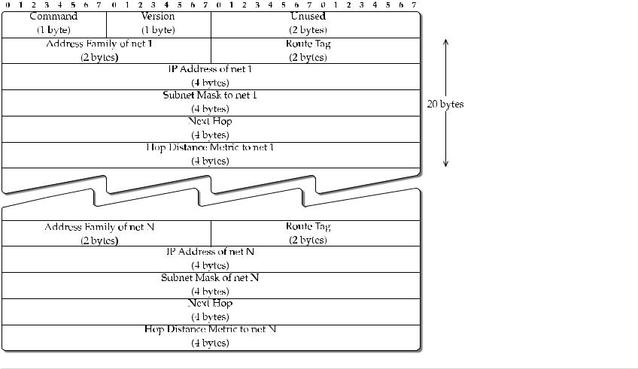
RIPv2 packet format

Slide 13
the first 4 bytes, is the same as in RIPv1; in this, case the version field is set to 2, and the must-be-zero field is labelled as unused while command can be either a request or a response. We now discuss the new ones beyond RIPv1:
Route Tag (2 bytes): this field is provided to differentiate internal routes within a RIP rout-ing domain from external routes. For internal routes, this field is set to zero. If a route is obtained from an external routing protocol, then an arbitrary value or preferably the autonomous system number of the external route is included here to differentiate it from internal routes.
Subnet mask (4 bytes): this field allows routing based on subnet instead of doing classfull routing, thus eliminating a major limitation of RIPv1. In particular, variable-length subnet masking (VLSM) may be used.
Next hop (4 bytes): typically, an advertising router is the best next hop from its own view point when it lets its neighbors know about a route; at least, this is the basic assumption. However, in certain unusual circumstances, an advertising router might want to indicate a next hop that is different from itself, such as when two routing domains are connected on the same Ethernet network .

Slide 14
Unlike RIPv1, RIPv2 allows a simple form of authentication. For the purpose of authentication, a first entry block of 20 bytes can be allocated for authentication instead of being a route entry.
That is, when authentication is invoked, a RIPv2 message can contain only a maximum of 24 routes since one route table entry is used up for authentication.
the authentication type is set to 2 to indicate that it is a simple clear-text password; then the remaining 16 bytes contain the clear-text password.
The packet format with authentication is shown in Figure
Certainly, a clear-text password is not a very good form of authentication. Thus, in practice, this is not used much.

Slide 15
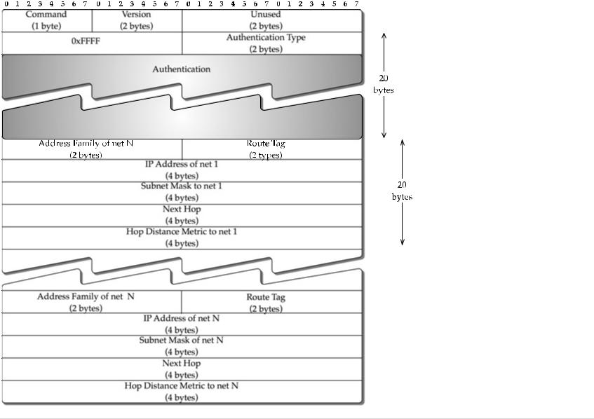
RIPv2 packet format with authentication

Slide 16
RIPv2 messages are multicast on 224.0.0.9 instead of broadcast as was done in RIPv1.
RIPv2 has been extended for use with IPv6 addressing; this extension is known as RIPng

Slide 17
Interior Gateway Routing Protocol (IGRP)
IGRP was developed by Cisco primarily to overcome the hop count limit and hop count metric of RIPv1. In general, IGRP differs from RIPv1 in the following ways:
IGRP runs directly over IP with protocol type field set to 9.
Autonomous system is part of the message fields.
Distance vector updates include five different metrics for each route, although one is not used in computing the composite metric.
External routes can be advertised.
It allows multiple paths for a route for the purpose of load balancing; this requires modification of the Bellman Ford computation so that instead of a single best path to a destination, multiple ‘almost’ equal cost paths can be stored.
IGRP’s normal routing update is sent every 90 sec on average with a variation of 10% to avoid synchronization. It has an invalid timer to indicate non reachability of a route; this is set to three times the value of the update period. It is important to note that IGRP does not support variable length subnet masking, much like RIPv1; this is an instance in which IGRP differs from RIPv2.

Slide 18
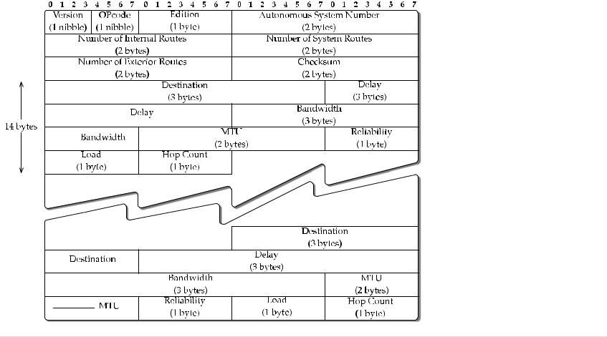
Packet format

Slide 19
Packet Format
IGRP packet is fairly compact consisting of 12-byte header fields followed by 14 bytes for each route entry (see Figure 5.6). The header field consists of the following fields:
Version (4 bits): This field is set to 1.
Opcode (4 bits): This field is equivalent to the command code in RIP. 1 is a Request and 2 is an Update. In case of a request, only the header is sent; there are no entries.
Edition (1 byte): A counter that is incremented by the sender; this helps prevent a receiving router from using an old update; it essentially plays the role of a timestamp.
Autonomous system number (2 bytes): ID number of an IGRP process.
Number of interior routes (2 bytes): A field to indicate the number of routing entries in an update message that are subnets of a directly connected network.
Number of system routes (2 bytes): This is a counterpart of the number of interior routes; this field is used to indicate the number of route entries that are not directly connected.
Number of exterior routes (2 bytes): The number of route entries that are default networks. This and the previous two fields, the number of interior routes and the number of system routes, together constitute the total number of 14-byte route entries.
Checksum (2 bytes): This value is calculated on the entire IGRP packet (header + entries).
For each route entry, there are seven fields that occupy 14 bytes:

Slide 20
Destination (3 bytes): This is the destination network for which the distance vector is generated. It seems confusing to see that this field is only 3 bytes instead of the standard 4 bytes for IP addresses.
However, for class full addresses, this is workable. If the update is for a system route, the first 3 bytes of the address are included;
for example, if IP address of a route is 192.168.1.0, entry 192.168.1 is listed in this field. On the other hand, if it is an interior route, the last 3 bytes are listed; for example, if the field lists 16.2.0 for an interior route that is received on interface 172.16.1.254/24, it is meant for the subnet 172.16.2.0.
Delay (3 bytes), bandwidth (3 bytes), reliability (1 byte), and load (1 byte): These fields are explained in Section 5.5.2 while discussing how the composite metric is computed.
Hop count (1 byte): A number between 0 and 255 used to indicate the number of hops to the destination.
MTU (2 bytes): The smallest MTU of any link along the route to the destination.

Slide 21
Enhanced Interior Gateway Routing Protocol (EIGRP)
EIGRP is another routing protocol from Cisco
it is a simple enhancement of IGRP.
The one thing in common between IGRP and EIGRP is the composite metric.
Although EIGRP is also from the distance vector protocol family, in many ways it is completely different from protocols such as RIP and IGRP.
A major difference is that EIGRP provides loop-free routing
EIGRP includes a hello protocol for neighbour discovery and recovery, and a reliable transfer mechanism for exchange of distance vector data
EIGRP includes a hello proto-col for neighbour discovery and recovery, and a reliable transfer mechanism for exchange of distance vector data

Slide 22
EIGRP is provided directly over IP using protocol number 88.
all EIGRP related message communication is multicast on the address 224.0.0.10;
acknowledgments are unicasted.
Since EIGRP requires reliable delivery, and given that the protocol is built directly over IP and multicast addressing is used, a reliable multicast mechanism is used.

Slide 23
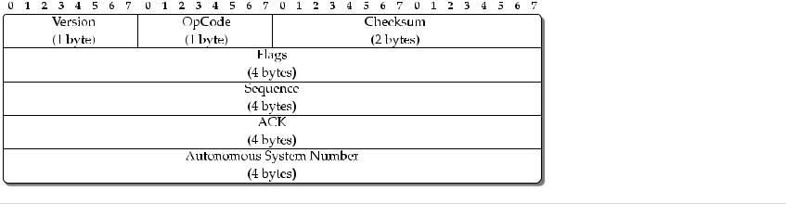
The EIGRP packet is divided into two parts: an EIGRP header part, which is 20 bytes long

Slide 24
The EIGRP packet is divided into two parts: an EIGRP header part, which is 20 bytes long, variable-length TLV (Type-Length-Value) format In the EIGRP header,
there are seven fields are described below
Version (1 byte): This field is set to 1.
Op Code (1 byte): This field is used to specify the EIGRP packet type. There are four key types for IP networks: update, query, reply, and hello. Note that the need for these fields has been already discussed in Section 3.3.5.
Checksum (2 bytes): Checksum is calculated over the entire EIGRP packet.
Flags: If this value is 1, it indicates a new neighbour relationship. This value is set to 2 to indicate a conditional receive bit for a propriety multicast algorithm Cisco implements for reliable delivery using the multicast address 224.0.0.10.
Sequence: This is a 32-bit sequence number used by the reliable delivery mechanism.
ACK: This field lists the sequence number from the last heard from neighbour. For an initial hello packet, this field is set to zero. A hello packet type with a nonzero ACK value is an acknowledgment to an initial hello message. An important distinction is that acknowledgment is sent as a unicast message; this ACK field is nonzero only for unicast.
Autonomous system number: This identifies the EIGRP domain.

Slide 25
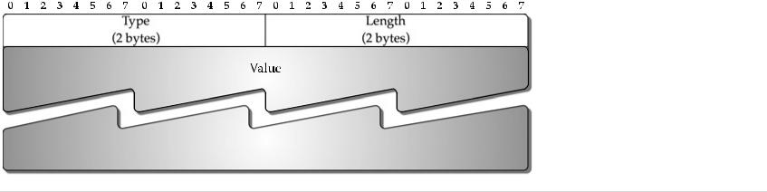
Data encoding in EIGRP packet: Generic TLV format

Slide 26
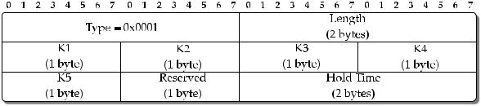
EIGRP: TLV type for EIGRP parameters

Slide 27
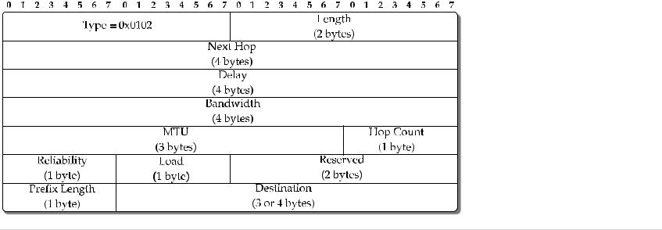
EIGRP: TLV type for communicating distance vector of an internal route

Slide 28
 | TA B L E
Protocol | RIPv1 | RIPv2 | IGRP | EIGRP |  | RIPng
Address | IPv4 | IPv4 | IPv4 | IPv4 |  | IPv6
Family
Metric | Hop | Hop | Composite | Composite |  | Hop
Information | Unreliable, | unreliable, | Unreliable, | Reliable, |  | Unreliable,
Communica- | broadcast | multicast | multicast | multicast |  | multicast
tion
Routing | Bellman | Bellman | Bellman | Diffusing |  | Bellman
Computation | Ford | Ford | Ford | computation |  | Ford
VLSM/CIDR | No | Yes | No | Yes |  | v6-based
Remark | Slow conver- | Slow conver- | Slow conver- | Fast, | loop- | Slow con-
 | gence; split | gence; split | gence; split | free | conver- | vergence;
 | horizon | horizon | horizon | gence; chatty |  | split hori-
 |  |  |  | protocol |  | zon

Slide 29
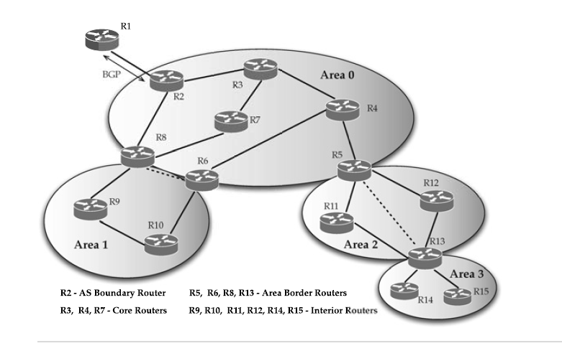
Router Classification

Slide 30
Area-Border Routers: These are the routers that sit on the border between the back bone and the low-level areas. Each area-border router must have at least one interface to the backbone; it also has at least one interface to each area to which it is connected
Internal Routers: These are the routers in each low-level area that have interfaces only to other internal routers in the same area.
Backbone Routers: These are the routers located in Area 0 with at least one interface to other routers in the backbone. Area-border routers can also be considered as backbone routers.
AS Boundary Routers: These routers are located in Area 0 with connectivity to other AS; they must be able to handle more than one routing protocol. For example, to exchangeinformation with another AS, they must be able to speak BGP. These routers also haveinternal interfaces for connectivity to other backbone routers.

Slide 31
Network Types
OSPF is designed to address five different types of networks:
(1) point-to-point networks
(2) broadcast networks
(3) non–broadcast multiaccess (NBMA) networks
(4) point-to-multipoint networks,
(5) virtual links.

Slide 32
Point-to-point networks refer to connecting a pair of routers directly by an interface/linksuch as OC-3. A router may be connected to multiple different routers by such point-to-point interfaces. Point-to-point links are typically used when an OSPF domain is spread out in a geographically distributed region.
Broadcast networks refer to networks such as LANs connected by a technology such as Ethernet. Broadcast networks, by nature, are multiaccess where all routers in a broadcast network can receive a single transmitted packet. In such networks, a router is elected as a Designated Router (DR) and another as a Backup Designated Router (BDR).

Slide 33
Non–broadcast multiaccess networks use technologies such as ATM or frame relay where more than two routers may be connected without broadcast capability. Thus, an OSPF packet is required to be explicitly transmitted to each router in the network. Such networks require an extra configuration to emulate the operation of OSPF on a broadcast network. Like broadcast networks, NBMA networks elect a DR and a BDR.
Point-to-multipoint networks are also non–broadcast networks much like NBMA networks;
however, OSPF’s mode of operation is different and is in fact similar to point-to-point links.

Slide 34
Virtual links are used to connect an area to the backbone using a nonbackbone (transit) area. Virtual links are configured between two area-border routers. Virtual links can also be used if a backbone is partitioned into two parts due to a link failure; in such a case, virtual links are tunnelled through a non backbone area. Consider again Figure Here Area 3 is connected to the backbone area using transit Area 2 through a virtual link that connects router 6 to router 7. Also note that if the link between router 2 and router 3 in the backbone area goes down, Area 0 becomes partitioned; to avoid that, a virtual link between Area-Border Routers 4 and 5 is established through Area 1.

Slide 35
Flooding
OSPF uses in-network functionality to flood routing information such as LSAs. In-network means OSPF packets are carried in the same network as user traffic. From the discussion above, we note that there are different possible network types. Thus, transmission of OSPF packets requires some tailoring.

Slide 36
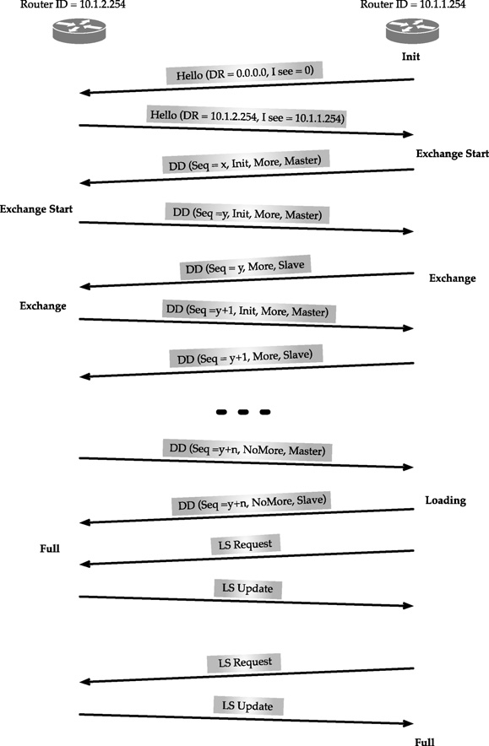
OSPF link state database synchronization process

Slide 37
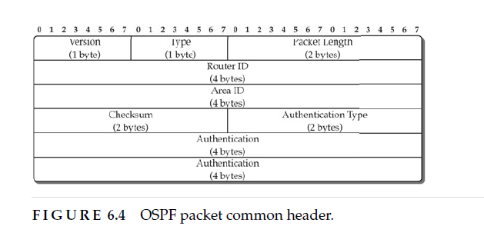
OSPF Packet Format

Slide 38
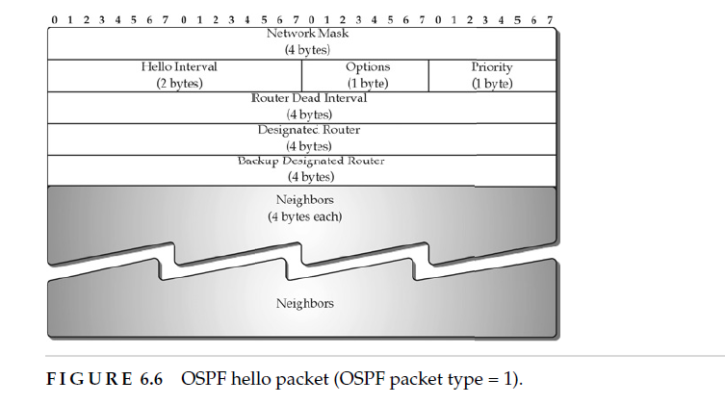
Hello packet -OSPF

Slide 39
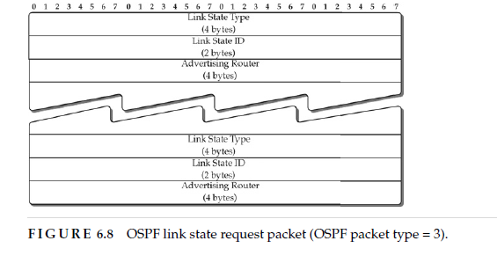

Slide 40
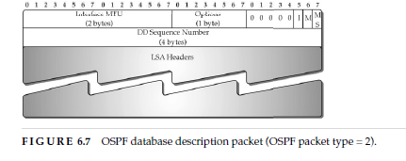

Slide 41
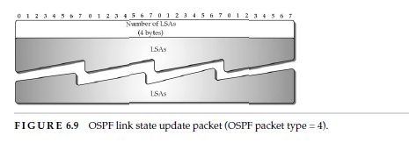

Slide 42
Integrated IS-IS(intermediate systems)
Similarities and Differences Between IS-IS and OSPF
SIMILARITIES
There are several similarities between IS-IS and OSPF:
• Both protocols provide network hierarchy through two-level areas.
• Both protocols use Hello packets to initially form adjacencies and then continue to maintain
them.
• Both protocols have the ability to do address summarization between areas.
• Both protocols maintain a link state database, and shortest path computation performed
using Dijkstra’s algorithm.
• Both protocols have the provision to elect a designated router for representing a broadcast
network.

Slide 43
Differences
With OSPF, an area border router can sit on the boundary between the backbone area and a low-level area with some interfaces in the area while other interfaces are in the other
area. In IS-IS, routers are entirely within one or the other area—the area borders are on links, not on routers.
While OSPF packets are encapsulated in IP datagrams, IS-IS packets are directly encapsulated in link layer frames.
The OSPF dimension-less link metric value is in the range 1 to 65,535, while IS-IS allows
the metric value to be in the range 0 to 63 (narrow metric), which has been extended to the range 0 to 16,777,215 (wide metric).
IS-IS being run directly over layer 2 is relatively safer than OSPF from spoofs or attacks.
IS-IS keepalives can be used for MTU detection since they are MTU-sized TLVs that are explicitly checksummed and need to be verified as such.
IS-IS allows overload declaration through an overload bit by a router to other routers.
This is used, for example, by other routers to not consider an overloaded router in path computation.

Slide 44
Traffic, Stochasticity, Delay, and Utilization
What Is IP Network Traffic?
Traffic data rate (Mbps) = Packets per sec × Average packet size (Megabits).
Delay = F(Traffic volume data rate, Capacity).
Delay = F(Traffic volume data rate, Capacity, Routing).

Slide 45


Slide 46
Thank you

